Slide 1
Law of Supply

Slide 2
Law of Supply
Law of supply in economics states that supply will increase as price increases, due to the fact that producers want to maximize profits. In this instance, the law assumes that all other factors are equal and price is the only independent element, meaning supply is completely dependent on the price. The concept of "quantity supplied" refers to the amount of the item that is available. Quantity has a close relationship with the price of the item. According to supply law, the quantity supplied will decrease when price decreases, as there's less opportunity for sellers to profit.

Slide 3
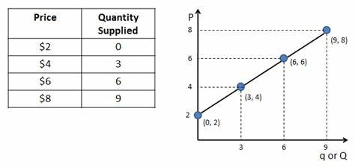
Supply Schedule and Supply Curve

Slide 4
Assumptions of Law of Supply
The phrase “keeping other factors constant or ceteris paribus” is used when describing the law of supply. This expression refers to the following presumptions that the law is based on:
The price of other commodities is constant.
The state of technology has not changed.
The price of factors of production is constant.
The taxation laws remain the same.
The producer’s objectives are constant.

